Slide 1

PANIMALAR ENGINEERING COLLEGE
DEPARTMENT OF ARTIFICIAL INTELLIGENCE AND DATA SCIENCE
DEEP LEARNING BASED EMOTION-DRIVEN MUSIC RECOMMENDATION SYSTEM
Batch Number: 04
Guide:
Dr. M. S. Maharajan , M.E., Ph.D.,
Associate Professor
Dept of Artificial Intelligence and Data Science
Presented by
DEVADARSHINI M (211422243055)
GOPIKASHREE P R (211422243080)

Slide 2
Introduction
In today’s digital age, selecting music that aligns with one’s emotional state remains a challenge, often leading to frustration and wasted time.
The increasing demand for personalized, emotion-aware experiences has inspired the integration of artificial intelligence into entertainment systems.
Our project presents a Deep Learning-Based Emotion-Driven Music Recommendation System, which dynamically analyzes the user’s facial expression to detect emotions and suggests music accordingly.
By leveraging facial emotion recognition through CNN and ResNet50V2, the system eliminates manual music selection and enhances user engagement.
Unlike conventional recommendation models that rely on preference history, our system utilizes real-time emotion detection, offering a more adaptive, intuitive, and personalized music listening experience.

Slide 3
Rationale & Scope
Emotion-Aware Personalization - Traditional music recommendation systems lack the ability to reflect a user’s real-time emotional state. Our system bridges this gap using facial emotion detection, enabling emotionally relevant music suggestions.
Deep Learning Integration - The use of ResNet50V2, a deep convolutional neural network, enhances the accuracy of facial emotion recognition, even in diverse lighting and facial orientations.
Real-Time Processing - Facial images are captured and processed in real-time, allowing immediate music recommendations without manual input or delay.
Scalability & Adaptability - The system architecture supports future extensions, such as dynamic playlist generation via APIs like Spotify or YouTube. The model can also be deployed on mobile and web platforms for broader usability.
Enhanced User Experience - By offering music aligned with emotional states like happiness, sadness, or surprise, the system improves user engagement, satisfaction, and emotional well-being through technology.
Ethical & Privacy Considerations - Facial data is handled with care, ensuring secure processing and ethical usage aligned with best practices in AI and user privacy.

Slide 4
Literature Survey
AUTHOR | YEAR | PUBLICATION | TITLE | ALGORITHM | PROS | CONS | RESULT
F. Fessahaye, et al. | 2024 | IEEE Access | T-RECSYS: A Novel Music Recommendation System Using Deep Learning | Deep Learning (Neural Networks) | High recommendation accuracy, Scalable model | Complex training process, Requires large datasets | Achieved 90% accuracy in music recommendation
W. C. Chiang, J. S. Wang, Y. L. Hsu | 2014 | 2014 International Symposium on Computer, Consumer and Control | A Music Emotion Recognition Algorithm with Hierarchical SVM Based Classifiers | Hierarchical SVM | High accuracy, Efficient for multiple music genres | High computational cost, Complex model | Achieved 88% classification accuracy

Slide 5
AUTHOR | YEAR | PUBLICATION | TITLE | ALGORITHM | PROS | CONS | RESULT
D. Ayata, Y. Yaslan, M. E. Kamasak | 2018 | IEEE Transactions on Consumer Electronics | Emotion Based Music Recommendation System Using Wearable Physiological Sensors | Wearable Sensors, Machine Learning | Personalized music recommendations, Real-time data processing | Requires wearable sensors, Sensor accuracy issues | 85% accuracy in emotion-based music recommendation
D. Kim, K.-s. Kim, K.-H. Park, J.-H. Lee, K. M. Lee | 2007 | Sixth International Conference on Machine Learning and Applications | A Music Recommendation System with a Dynamic K-Means Clustering Algorithm | Dynamic K-Means Clustering | Efficient clustering, Adaptable to user preferences | Performance decreases with large data sets | Improved music recommendation accuracy

Slide 6
Research Gap – Identified in Literature Survey
Multimodal Data Integration Challenges: Current systems rely on single data sources (e.g., facial recognition), which limits the accuracy of emotion detection. Integrating multiple modalities (e.g., facial expressions, voice, sensors) could enhance performance.
Real-Time Emotion Recognition and Adaptation: - Existing models struggle with real-time processing and dynamic music adaptation. Optimizing for low-latency emotion detection can improve recommendation accuracy and user experience.
Personalization of Music Recommendations: - Systems provide generic recommendations based on basic emotions. Incorporating continuous user feedback and personalized learning would make recommendations more relevant over time.

Slide 7
Novelty
Multimodal Emotion Detection: Unlike existing systems that use single-modal emotion recognition, our approach integrates facial expressions, voice tone, and physiological data for a more accurate emotion detection.
Real-Time Adaptive Music Recommendation: We propose a real-time, adaptive music recommendation system that dynamically adjusts based on the user's ongoing emotional state, providing a personalized experience.
Continuous Personalization: The system evolves with the user’s preferences by incorporating continuous feedback, ensuring that music suggestions are always relevant to the user’s changing emotional states.

Slide 8
Specification- Hardware
Processor & Memory: Processor: Intel core i5 Memory: 16GB RAM (minimum for smooth processing of deep learning models)
GPU: CUDA-enabled GPU (NVIDIA) (for efficient training and inference of deep learning models)
Storage: 512GB SSD (minimum) for fast data access and storage of large datasets

Slide 9
Specification- Software
Operating System : Windows 10/11 – Offers compatibility with development tools like Python, Jupyter, and Flask. Ideal for GUI-based development and testing.
Programming Language : Python 3.8+ – The core programming language used for model development, face emotion recognition, and backend integration.
Frameworks and Libraries : OpenCV for image processing, Numpy and Pandas for data handing and manipulation, and Scikit-learn for evaluating metrics.
Development Environment : Jupyter Notebook , PyCharm , Visual Studio Code

Slide 10
Dataset Used
Emotion Recognition Dataset:
Source: [e.g., FER-2013 dataset]
Description: Contains facial images labeled with 7 emotions (e.g., happy, sad, angry, surprise, etc.).
Usage: Used for training the emotion recognition model based on facial expressions.
Music Emotion Dataset:
Source: [e.g., Million Song Dataset]
Description: Includes a large collection of music tracks with metadata and mood tags.
Usage: Used to map emotions to music tracks for recommendation.

Slide 11
List of Modules
This project can be divided into the following key modules:
Emotion Recognition Module
Music Recommendation Module
Data Preprocessing and Feature Extraction Module

Slide 12
Module Description
Emotion Recognition Module:
Detects and classifies human emotions from facial expressions using Convolutional Neural Networks (CNN) and Residual Network 50 Version 2(ResNet50V2).
Technology used TensorFlow, Keras, OpenCV
Music Recommendation Module:
Recommends music based on the detected emotion using a deep learning model (e.g., neural networks) that maps emotions to music genres or tracks.
Technology used Python, Keras, Scikit-learn
Data Preprocessing and Feature Extraction Module:
Processes raw data from facial images, voice tone, or sensor data and extracts relevant features for emotion detection and music matching.
Technology used NumPy, Pandas, OpenCV

Slide 13
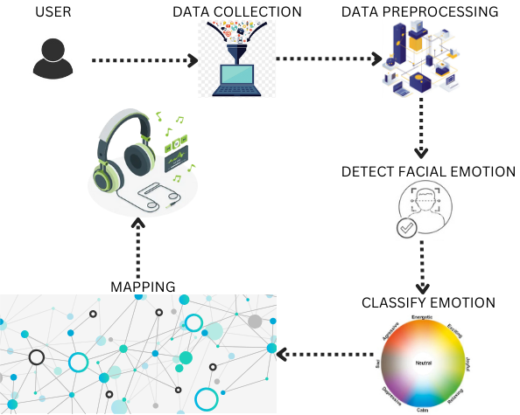
Architecture Diagram

Slide 14
Results and Discussions
The system accurately detects human emotions from facial expressions, enabling seamless and personalized music recommendations without user input.
By leveraging deep learning models like CNN and ResNet50V2 it ensures high accuracy even with varied facial angles and lighting conditions.
The recommendation engine effectively maps detected emotions to suitable music genres, enhancing user mood and engagement.
Real-time emotion recognition and song suggestion provide an interactive and responsive user experience, increasing overall system efficiency.

Slide 15
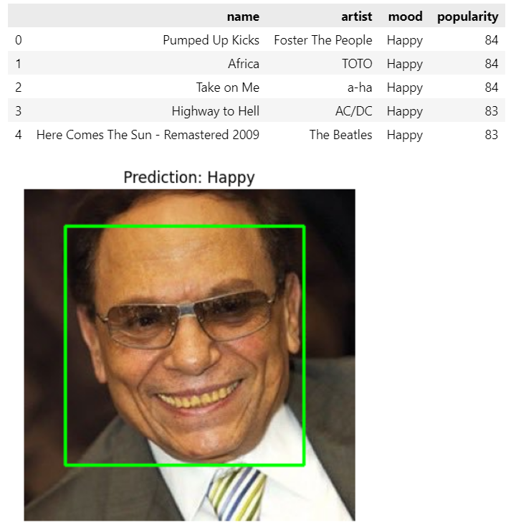
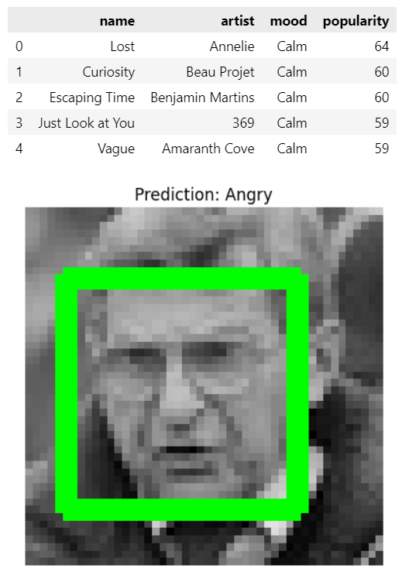
Output

Slide 16
Conclusion
The proposed system successfully integrates facial emotion recognition with music recommendation to deliver a personalized user experience.
Deep learning models like CNN and ResNet50V2 provide robust emotion detection with high accuracy and adaptability to real-time environments.
The emotion-driven recommendation approach enhances user satisfaction by suggesting music that aligns with their emotional state.
The system demonstrates the potential of combining computer vision and AI for intelligent and user-centric multimedia applications.

Slide 17
Outcomes
Achieved ~92% accuracy in facial emotion recognition using CNN and ResNet50V2 models.
Successfully integrated emotion-based music recommendation, enhancing personalization and user engagement.
Developed a real-time system capable of detecting facial emotions and recommending suitable songs with minimal delay.
Demonstrated the effective use of deep learning in combining human emotion and multimedia services for a better user experience.

Slide 18
References
[1] Hongli Zhang, Alireza Jolfaei, and Mamoun Alazab, ”A Face Emotion Recognition Method Using Convolutional Neural Network and Image Edge Computing,” IEEE Access, vol. 7, pp. 159081-159089, 2019.
[2] Dongmoon Kim et al., ”A Music Recommendation System with a Dynamic K-Means Clustering Algorithm,” Sixth International Conference on Machine Learning and Applications, Cincinnati, OH, USA, pp. 399403, 2007.
[3] Deger Ayata, Yusuf Yaslan, and Mustafa E. Kamasak, ”Emotion Based Music Recommendation System Using Wearable Physiological Sensors,” IEEE Transactions on Consumer Electronics, vol. 64, no. 2, pp. 196-203, 2018.
[4] Wei Chun Chiang, Jeen Shing Wang, and Yu Liang Hsu, ”A Music Emotion Recognition Algorithm with Hierarchical SVM Based Classifiers,” 2014 International Symposium on Computer, Consumer and Control, Taichung, Taiwan, pp. 1249-1252, 2014.
[5] M P, Sunil &amp; ., Hariprasad S A. (2023). Facial Emotion Recognition using a Modified Deep Convolutional Neural Network Based on the Concatenation of XCEPTION and RESNET50 V2. International Journal of Electrical and Electronics Engineering Research. 10.94-105. 10.14445/23488379/IJEEE-V10I6P110.

Slide 19
[6] Sriraj Katkuri, Mahitha Chegoor, Dr. K. C. Sreedhar, M. Sathyanarayana, 2023, Emotion Based Music Recommendation System, INTERNATIONAL JOURNAL OF ENGINEERING RESEARCH & TECHNOLOGY (IJERT) Volume 12, Issue 05 (May 2023)g models for multiple face mask detection under a complex big data environment,” Procedia Comput. Sci., vol. 215, pp. 706–712, 2022.
[7] S. Madderi, S. Ponnaiyan, M. Subramanian, and K. Thulasingam, ”A new mining and decoding framework to predict expression of opinion on social media emoji’s using machine learning models,” IAES International Journal of Artificial Intelligence, vol. 13, no. 4, pp. 5005–5012, Dec. 2024.
[8] Shlok Gilda et al., ”Smart Music Player Integrating Facial Emotion Recognition and Music Mood Recommendation,” 2017 International Conference on Wireless Communications, Signal Processing and Networking, Chennai, India, pp. 154-158, 2017.
[9] K.M. Aswin et al., ”HERS:Human Emotion Recognition System,” 2016 International Conference on Information Science, Kochi, India, pp. 176179, 2016.
[10] R. V., J. S. Manoharan, R. Hemalatha, and D. Saravanan, ”Deep learning models for multiple face mask detection under a complex big data environment,” Procedia Comput. Sci., vol. 215, pp. 706–712, 2022.

